Slide 1


Theory- 5G Network Architecture & Open Radio Access Network (Open RAN)
Arnova Abdullah
Research Project: Investigation of Vulnerabilities in Open RAN Implementations
Weekly meeting-02 (26.10.2022)

Slide 2
Previous Week 1 (19.10.2022)
Basics about Radio Access Network (History, parts of RAN for 1G, 2G, 3G, 4G)
Basics about Open RAN (Distribution unit, central unit, user plane, control plane, interfaces, front haul, mid haul, backhaul)
Open RAN risk analysis (Stakeholders of attackers-User, external attacker, cloud operator**, RAN operator**)

Slide 3
Week - 02 Meeting (26.10.2022)
Installation of Kali Linux and Metasploitable
Atomic Red Team GitHub repository download
Research other open-source attack tools

Slide 4
Installation of Kali Linux and Metasploitable
Importing Kali Linux VM into Oracle virtual box
Importing Metasploitable2 VM into Oracle virtual box
It is a vulnerable system that can be attacked by Kali Linux.
Checking the connectivity between Kali Linux and Metasploitable2 by pinging each other from these two virtual Machines
Checking network scanning of metasplitable2 by Nmap

Slide 5
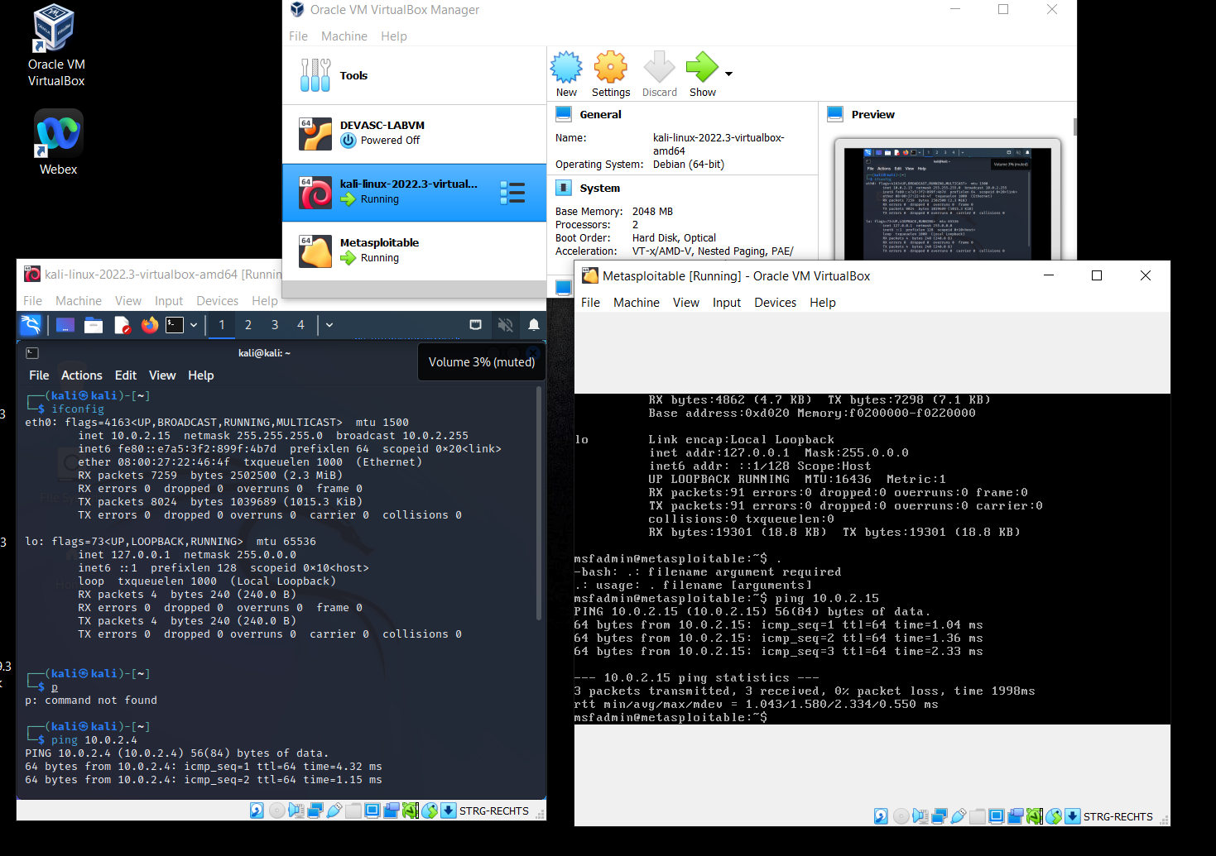
Installation of Kali Linux and Metasploitable

Slide 6
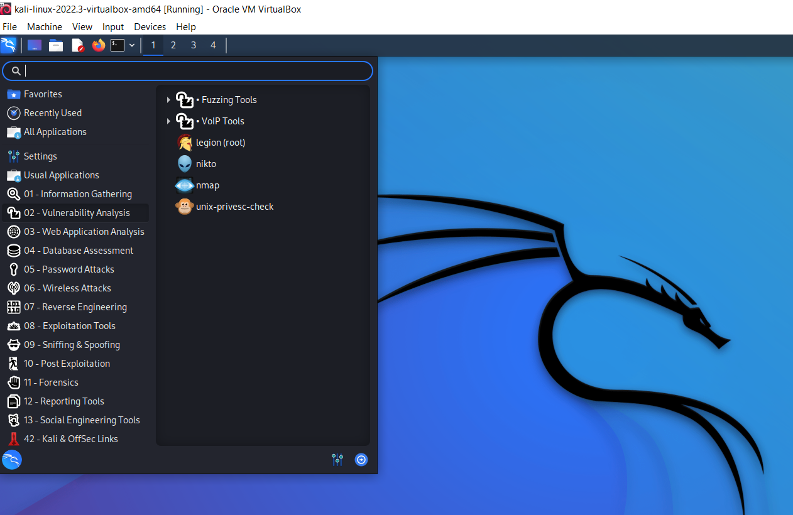
Installation of Kali Linux and Metasploitable

Slide 7
Installation of Kali Linux and Metasploitable
For Kali Linux, a lot of youtube resources are available.
Different applications of Kali Linux are open to being learned.

Slide 8
Atomic Red Team GitHub repository download
Atomic red team GitHub zip file downloaded from
https://github.com/redcanaryco/atomic-red-team#readme
Atomic tests are run in the power shell by Invoke-Atomic.
There are different techniques with ID
https://atomicredteam.io/atomics/
This technique with ID can be invoked to run a test
https://github.com/redcanaryco/invoke-atomicredteam/wiki/Execute-Atomic-Tests-(Local)

Slide 9
Atomic Red Team GitHub repository download
Atomic red team has a wiki page where all the details can be found
Also there are some youtube videos
I have not tried any tests yet

Slide 10
Research other open-source attack tools
3 other open source attack tools found
Caldera
Mitre Mordor
Infection Monkey

Slide 11
Research other open-source attack tools
(Caldera)
MITRE ATT&CK® is a globally-accessible knowledge base of adversary tactics and techniques based on real-world observations.
https://attack.mitre.org/
CALDERA is built on the MITRE ATT&CK™ framework and is an active research project at MITRE.
https://caldera.readthedocs.io/en/latest/
This is also a GitHub project, that needs to be downloaded or cloned from the git repository.
Whether this can be used for 5G open RAN or not, this is not yet researched.

Slide 12
Research other open-source attack tools
(Mitre Mordor)
The Mordor project provides pre-recorded security events generated after simulating adversarial techniques.
This is also available on GitHub.
https://github.com/OTRF/Security-Datasets

Slide 13
Research other open-source attack tools
(Infection Monkey)
The Infection Monkey is an open-source breach and attack simulation (BAS) platform that
helps validate existing controls and identify how attackers might exploit current network security gaps.
Infection Monkey can be downloaded from
https://www.akamai.com/infectionmonkey

Slide 14
Next Steps (Week 3) (Until 2.11.2022)
Penetration testing using Kali Linux
https://www.youtube.com/watch?v=ng1bvXsp9ZA
Try atomic tests by invoke-atomic
Get used to commands used for running a test
https://www.youtube.com/watch?v=7guUoRQEEiE&list=PL92eUXSF717W9TCfZzLca6DmlFXFIu8p6&index=6
Research details about one of the attack tools (maybe Infection Monkey)
Read research papers on risk of 5G open RAN
https://program.mch2022.org/media/mch2022/submissions/8BEFCG/resources/220723.OpenRAN_Security-MCH2022_Karsten_Nohl_yKotUaV.pdf

